Slide 1
Firebase Cloud Messaging
Group Members:
Muhammad Hassan Tariq (16L-4177)
Rabiya Adnan (16L-4356)
Maham Masood (16L-4072)

Slide 2
What is it?
Firebase Cloud Messaging (FCM) is a cross-platform messaging solution that lets you reliably deliver messages at no cost.
Formerly known as Google Cloud Messaging (GCM)
Service provided by firebase
Messages and notifications for Android, iOS, web applications

Slide 3
Key capabilities
Send notification messages or data messages
Versatile message targeting
Send messages from client apps

Slide 4
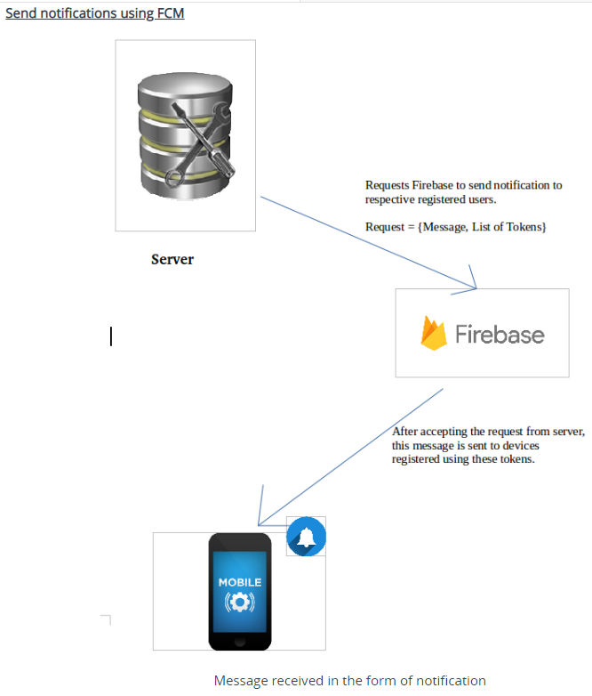
How does it work?

Slide 5
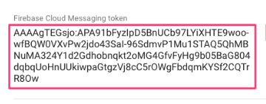
Tokens
FCM targets devices using encrypted, alpha numeric tokens
Unique to every device.
Must be kept secret.
FirebaseMessagingService turns on automatically whenever a new token is generated for a device

Slide 6
Main Functions
onTokenRefresh(): Called if the system determines that the token needs to be refreshed. Once the token is retrieved, you can save it to your server and store it.
onMessageReceived(): In order to receive messages, we have to override this callback from our FireBaseMessagingService class.

